Slide 1

Development PROJECT
Regex Matching Web App
Name: Mohammad Wasiq
Intern ID: IN9240653
E-mail: gl0427@myamu.ac.in

Slide 2
Objective
Your task is to replicate the core functionality of the website regex101.com. This entails creating a web application that allows users to input a test string and a regular expression (regex) and displays all the matches found.
Link: https://irl-regex-matching-web-app.streamlit.app/

Slide 3
Steps
1. Create a new directory for your project and navigate into it.
2. Set up your virtual development environment:
- Install Flask, a Python web framework, using pip if not already installed: `pip install Flask`.
3. Initialize a new Flask application:
- Create a new Python file named `app.py`.
- Import Flask and create a new Flask app instance.
- Define a route for the home page ("/") where users can input the test string and regex.
- Render an HTML template containing a form with fields for the test string and regex, and a submit button.

Slide 4
Steps
4. Create the HTML template:
- Create a new directory named `templates` within your project directory.
- Inside the `templates` directory, create a new HTML file named `index.html`.
- Design the HTML form with input fields for the test string and regex, and a submit button.
5. Define a route to handle form submission:
- Define a new route ("/results") in your `app.py` file to handle form submission.
- Extract the test string and regex submitted by the user from the form data.
- Use Python's `re` module to perform regex matching on the test string.
- Store the matched strings in a list.

Slide 5
Steps
6. Render the results:
- Pass the list of matched strings to the HTML template.
- Modify the HTML template to display the matched strings below the input form.
7. Test your application:
- Run your Flask application ( python app.py ).
- Open a web browser and navigate to http://localhost:5000 to access your application.
- Input various test strings and regex patterns to ensure the application displays the correct matches.

Slide 6
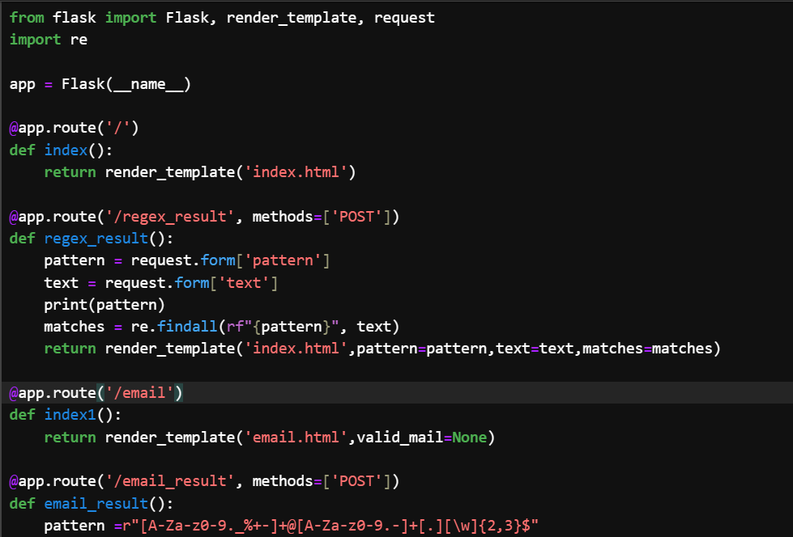
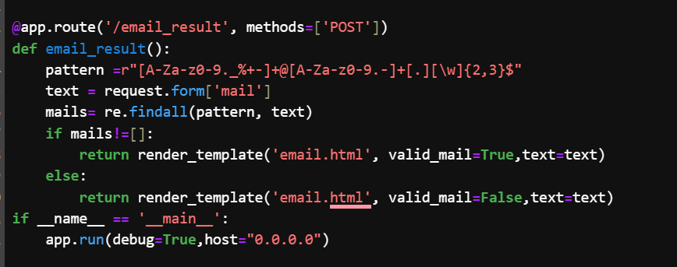
app.py Code

Slide 7
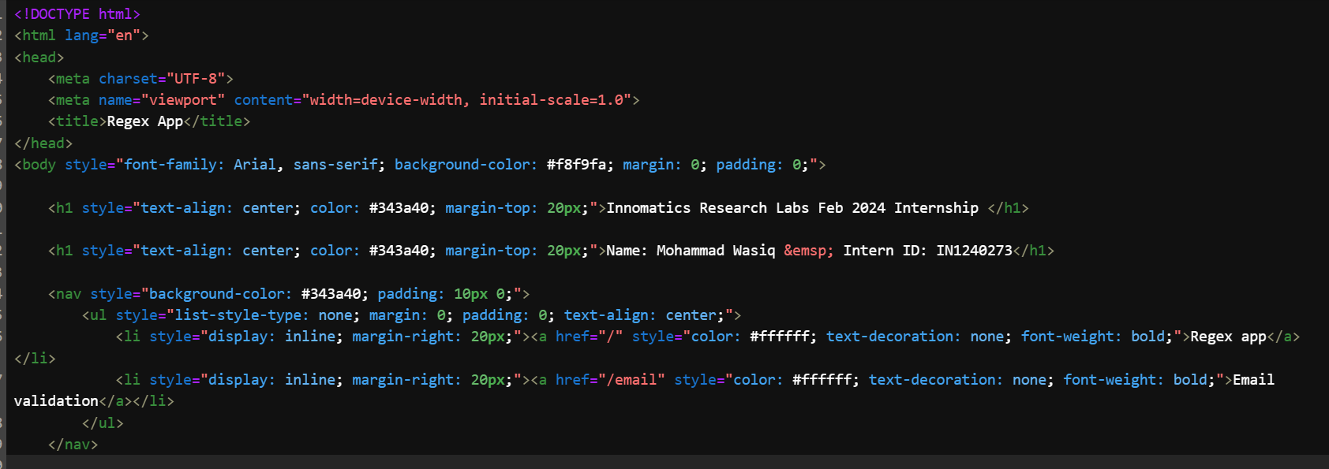
index.html

Slide 8
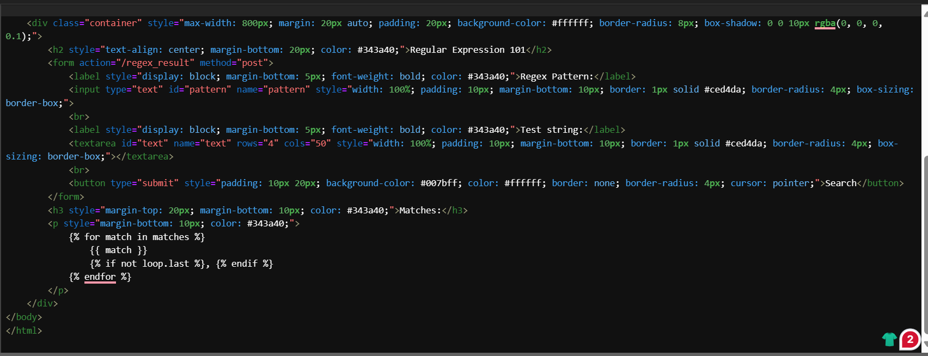
index.html

Slide 9
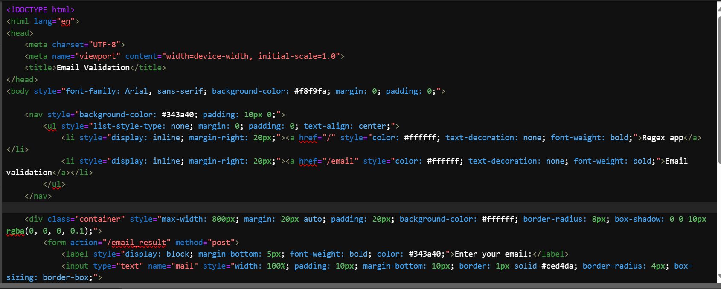
email.html

Slide 10
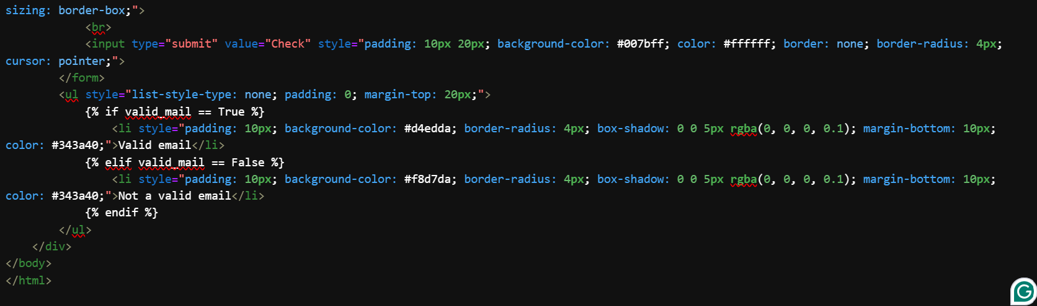
email.html

Slide 11
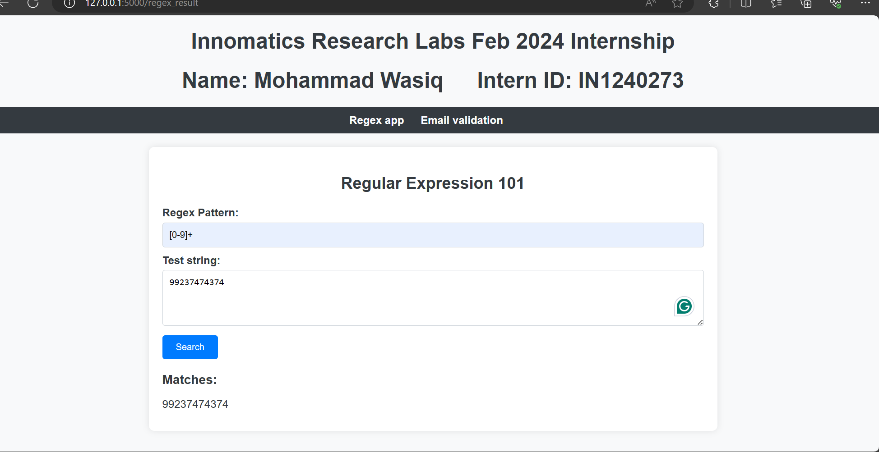
After Execution Code my code is successfully run

Slide 12
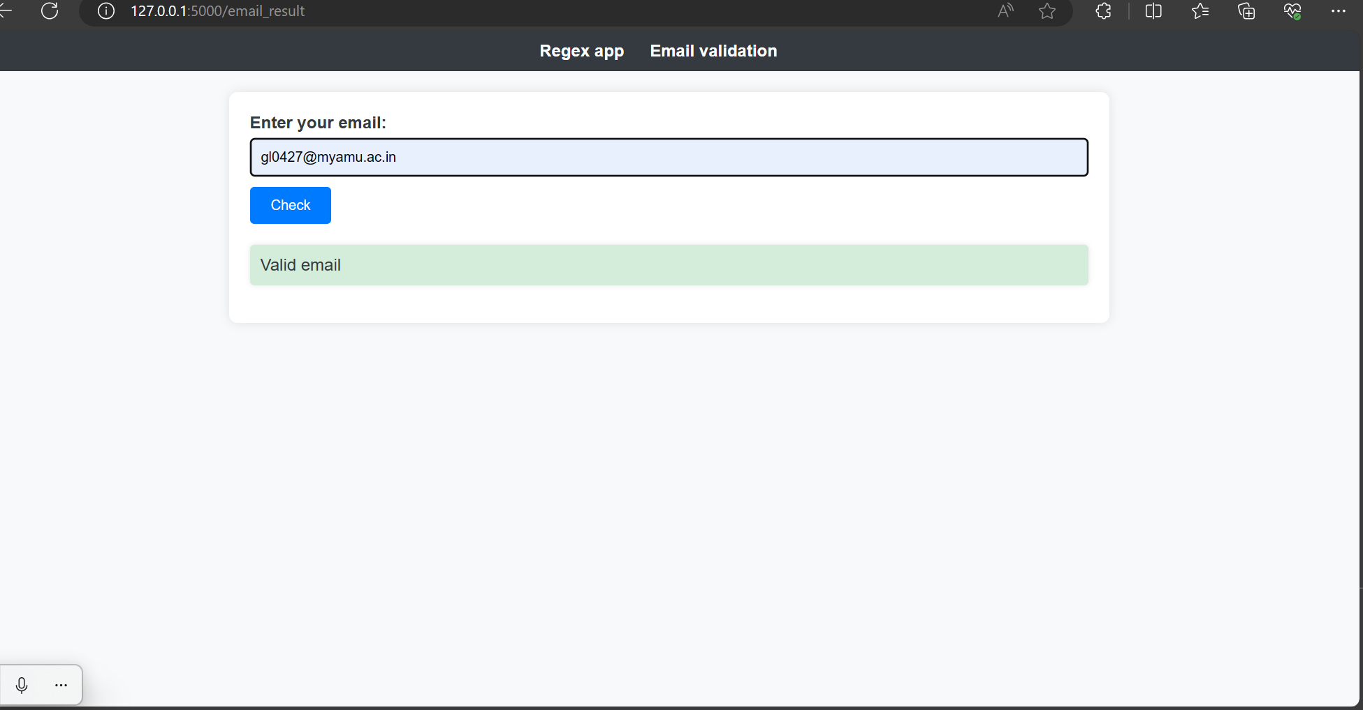

Slide 13
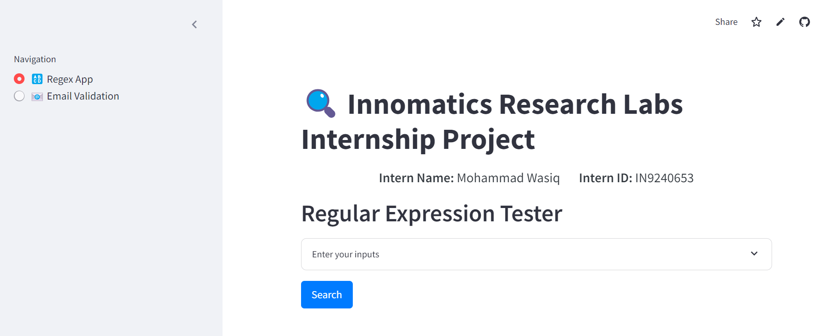
Streamlit App Depoyment
https://irl-regex-matching-web-app.streamlit.app/

Slide 14
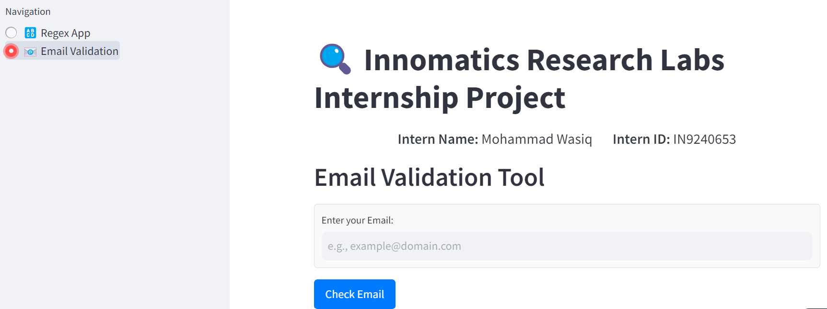
Streamlit App Depoyment
https://irl-regex-matching-web-app.streamlit.app/

Slide 15
THANK YOU

